Slide 1















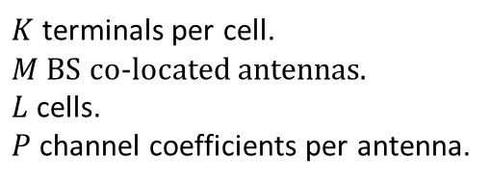
Scatter point
$$g_{ilkm}^{(1)}$$
…
$$x_{l1}$$
$${BS}_{l}$$
$$g_{ilkm}^{(p)}$$
$$x_{lK}$$
$$x_{lk}$$
$$x_{i3}$$
…
$$m$$
$$x_{i1}$$
$$x_{iK}$$
$$x_{l2}$$
$$g_{ilkm}^{(P)}$$
$$x_{i2}$$
$${BS}_{i}$$
$$x_{ik}$$
$K$ terminals per cell.
$M$ BS co-located antennas.
$L$ cells.
$P$ channel coefficients per antenna.

Slide 2
Scatter point
$$g_{ilkm}^{(1)}$$
…
$$x_{l1}$$
$${BS}_{l}$$
$$g_{ilkm}^{(p)}$$
$$x_{lK}$$
$$x_{lk}$$
$$x_{i3}$$
…
$$m$$
$$x_{i1}$$
$$x_{iK}$$
$$x_{l2}$$
$$g_{ilkm}^{(P)}$$
$$x_{i2}$$
$${BS}_{i}$$
$$x_{ik}$$
$K$ terminals per cell.
$M$ BS co-located antennas.
$L$ cells.
$P$ channel coefficients per antenna.

